Slide 1
Testing Session-6

Slide 2
Agenda
Software Testing Life Cycle
Test scenario
Test case
Test plan Template
Test Strategy and Test Plan
Requirement Traceability Matrix(RTM)

Slide 3
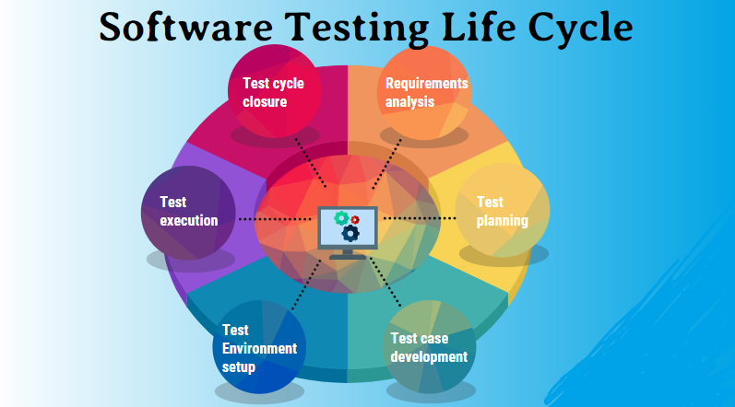
Software Testing Life Cycle
Requirement Analysis
Test Planning
Test Scenario / Test Case Design
Test Environment Setup
Test Execution
Test Closure

Slide 4
Test Scenario
Functionality
Test Case
Check list , To validate functionality
What to test and how to test
Use Case
Is a document consists of requirements

Slide 5
Stages in STLC:

Slide 6
Test plan Template

Slide 7
Test plan objectives
Scope
Approaches
Resources
Schedules
What , How, When, Whom?

Slide 8
Test Strategy
Testing approaches to achieve the testing objectives
Project manager
Organisation level

Slide 9
Requirement Traceability Matrix(RTM)
Forward Traceability Matrix
Backward Traceability Matrix
Bi-directional Traceability Matrix
Advantages of RTM
Test coverage
Gaps ,document inconsistency
Execution Status

Slide 10
Why Swhizz?
Following the project-oriented training By working on user stories
Real time people will deliver the classes
Hands on experience.
One to One monitoring
Interaction sessions
Doubts Clarification Session
Expertise in resume preparation
Mock interviews
Job assistance
Associated with 50+ Clients
900+ students got placed

Slide 11

Any Queries?

Slide 12
Thank You
Mr.SubbaRao (Relationship Manager)
Contact:9059002244

